Slide 1
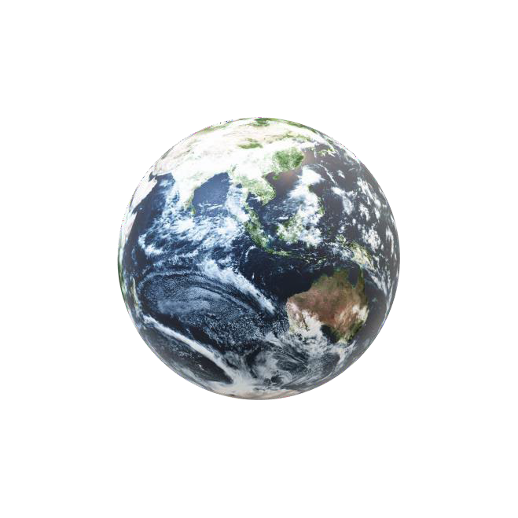




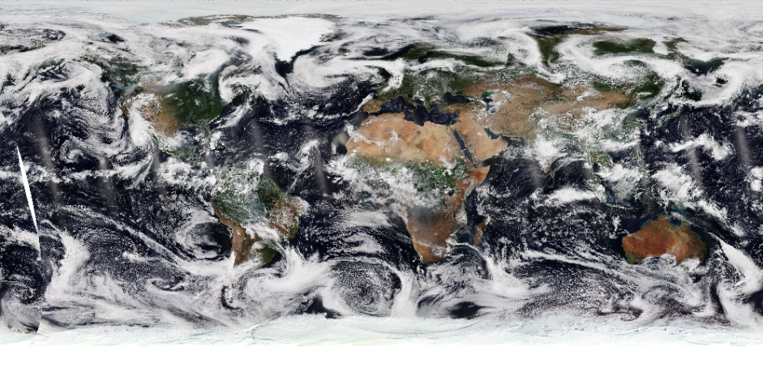


AI-based frame interpolation, video generation and display system for WMS services
Satellite Image Capture (Every 30 minuties)
AI-powered Frame Interpolation & Video Generation:
The system uses frame interpolation to generate smooth minute-by-minute animations by filling gaps between satellite images, ensuring continuous and high-quality visualizations. Automated video generation compiles these interpolated frames into seamless videos.
Image Pre-processing ( Clean and Normalize)
WebGIS Integration & Interactive Maps:
Integration with open-source WebGIS technologies like OpenLayers enables the display of videos on an interactive browser-based map and application software, providing real-time spatial context for dynamic phenomena, such as moving clouds.
AI- powered Frame Interpolation Model
Frame Assembly & Video-Generation
User-friendly Interface for Accessibility:
An intuitive user interface enhances the experience, allowing users to interact directly with the videos, improving accessibility and making complex satellite data more navigable.
User Interface (UI) (Video Playback & Interaction)
WebGIS Integration & Interactive Map Display

Slide 2
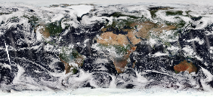

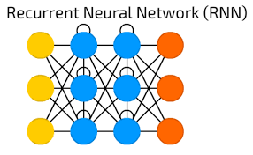






TECHNICAL APPROACH
1. AI - Frame Interpolation
2. Video Generation & Integration
3. Standards & Compatibility
The system utilizes advanced AI algorithms, including CNNs such as U-Net and Mask R-CNN, for frame interpolation between satellite images. These algorithms are instrumental in filling gaps and creating smooth animations. Additionally, LSTM-based RNNs and CNNs can be employed to enhance temporal continuity and accuracy in the interpolation process, resulting in detailed and fluid visualizations of dynamic phenomena. Another solution to this would be a transformer model.
The automated video generation component compiles the interpolated frames into seamless videos, ensuring continuous and coherent visualization. These videos are then integrated with open-source Web-GIS technologies like OpenLayers, which allows for interactive overlays on maps. This integration facilitates real-time spatial visualization, providing users with an engaging and informative platform for exploring satellite data.
To ensure practical application and broad compatibility, the system incorporates OGC-compliant WMS services. This adherence to widely used mapping standards enhances the interoperability of the solution with existing geographic information systems and platforms, ensuring that the generated videos can be seamlessly integrated into various mapping and visualization tools.

Slide 3
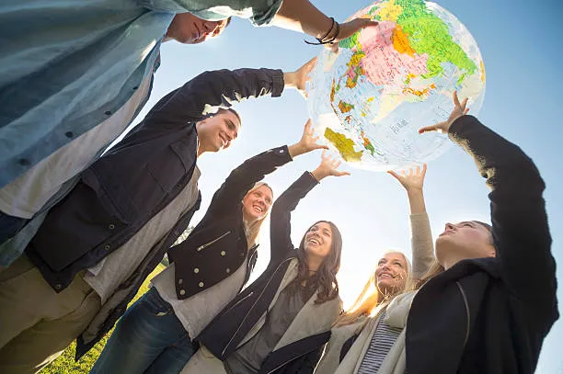
FEASIBILITY AND VIABILITY
Technical Feasibility:
AI models like CNNs, U-Net, and Mask R-CNN are effectivefor frame interpolation. Python, with libraries like TensorFlow and PyTorch, supports development.
Operational Feasibility:
Integrating AI-generated videos with WebGIS libraries like OpenLayers is viable and ensures smooth performance.
Economic Viability:
Using open-source technologies reduces costs. The solution has potential applications in weather forecasting and environmental monitoring.
Scalability:
The system can handle large volumes of data and generate real-time videos, making it adaptable for various use cases.

Slide 4

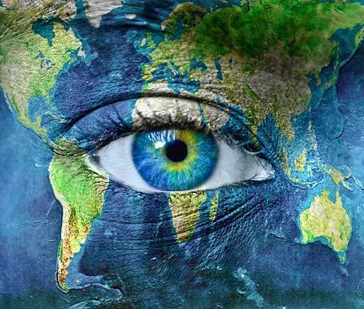
IMPACT AND BENEFITS
Impact on Target Audience:
Enhanced Visualization:
Provides smooth, continuous videos of satellite imagery, improving the visualization of dynamic phenomena like moving clouds.
Accessibility:
Makes satellite imagery more accessible and interactive for developers and end-users through a user-friendly interface.
Real-Time Monitoring:
Enables real-time monitoring of environmental changes, aiding in weather forecasting and disaster management.
Cost-Effective:
Utilizes open-source technologies, reducing costs and making the solution economically viable.
Scalability:
The system can handle large volumes of data, making it adaptable forvarious applications and scalable for future needs.

Slide 5




RESEARCH AND REFERENCES
1. DeepCloud: An Investigation of Geostationary Satellite Imagery Frame Interpolation for Improved Temporal Resolution:
This paper discusses a deep-learning methodology to enhance the temporal resolution of multi-spectral weather products from geostationary satellites using frame interpolation.
Access the paper here
2. Temporal Interpolation of Geostationary Satellite Imagery With Optical Flow:
This work presents a novel application of deep learning-based optical flow to temporal up sampling of geostationary satellite imagery, enhancing the temporal frequency of observations.
Read more about it here
3. Satellite Imagery and AI - A New Era in Ocean Conservation:
This paper introduces specialized computer vision models for various types of satellite imagery, highlighting the importance of reliable machine learning models in global applications.
More details can be found here.

